Slide 2
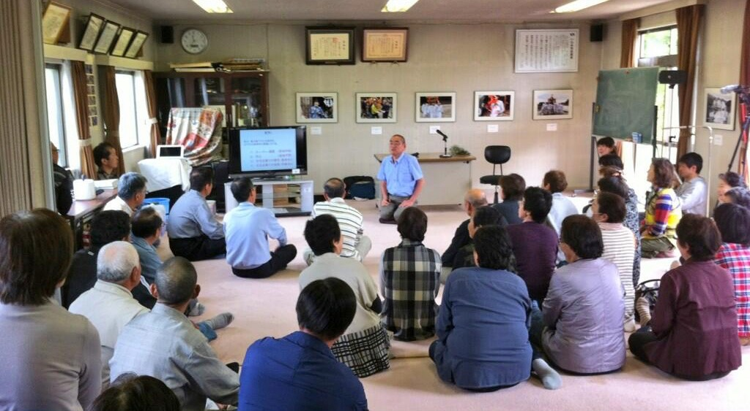
Community-Wide Whole Body Counter Measurement
1st: June 2013 124 people
2nd: October 2013
34
3rd: July 2014
39
〜
7th: October 2016
Throughout the whole period, 99% people were less than 300 bq/body

Slide 3
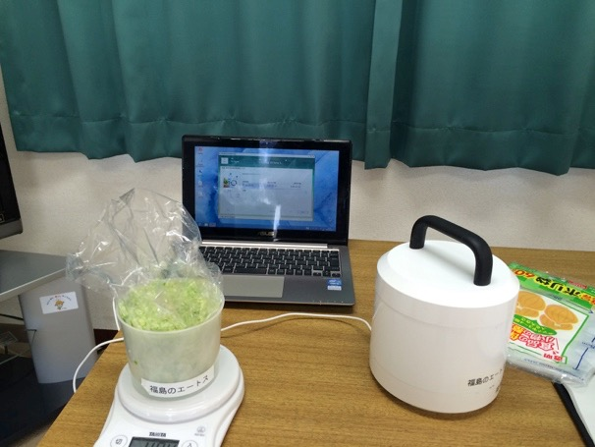
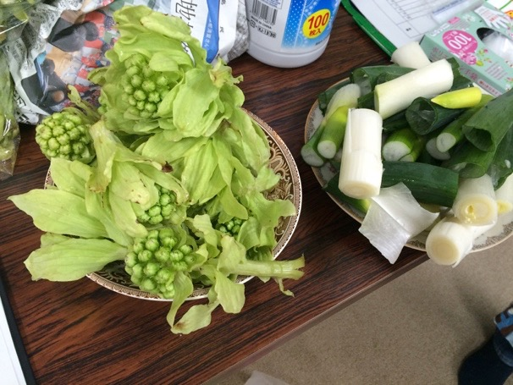
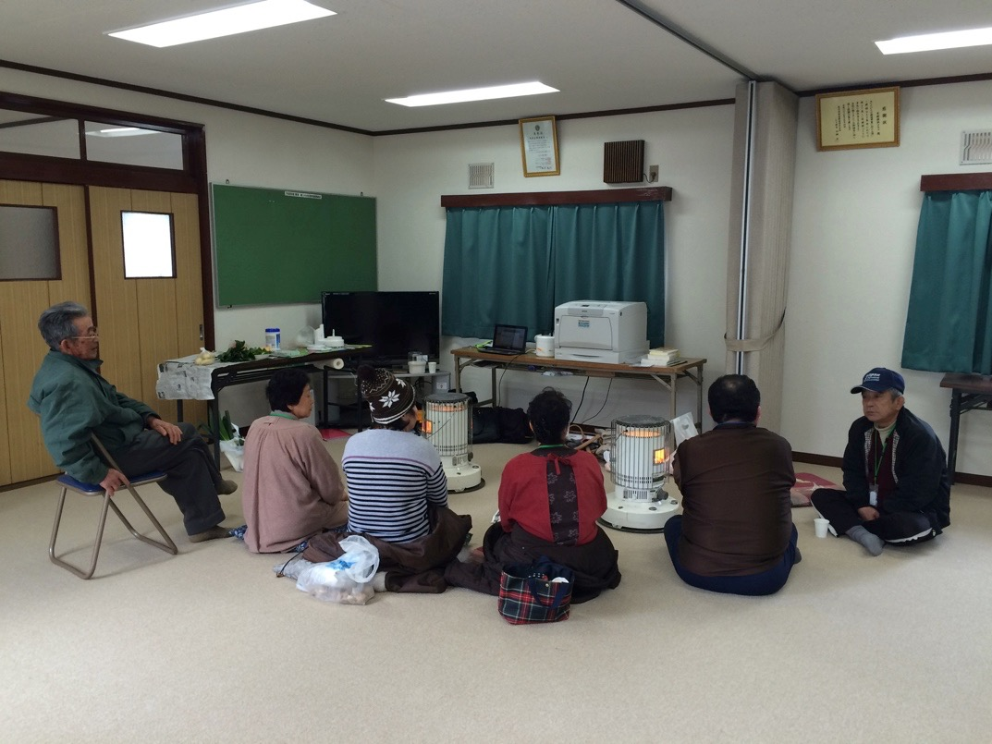
Foodstuff Measurement
On every Tuesday, measurements have been done at a community center in Suetsugi.
Home-grown vegetables
Sansai (wild herbs)
etc.
Nearly all vegetables: ND
But:
Fruits,
Mushrooms,
Sansai

Slide 4
Recognition Gap between Experts and Residents for the Measurement Results
Experts:
“There should not be any effect on health from this level of radiation. No problem.”
“It is hard to understand why they are still concerned.”
Residents:
”Ok, I see, it’s low level.”
“But still, our lives are greatly affected.”

Slide 5
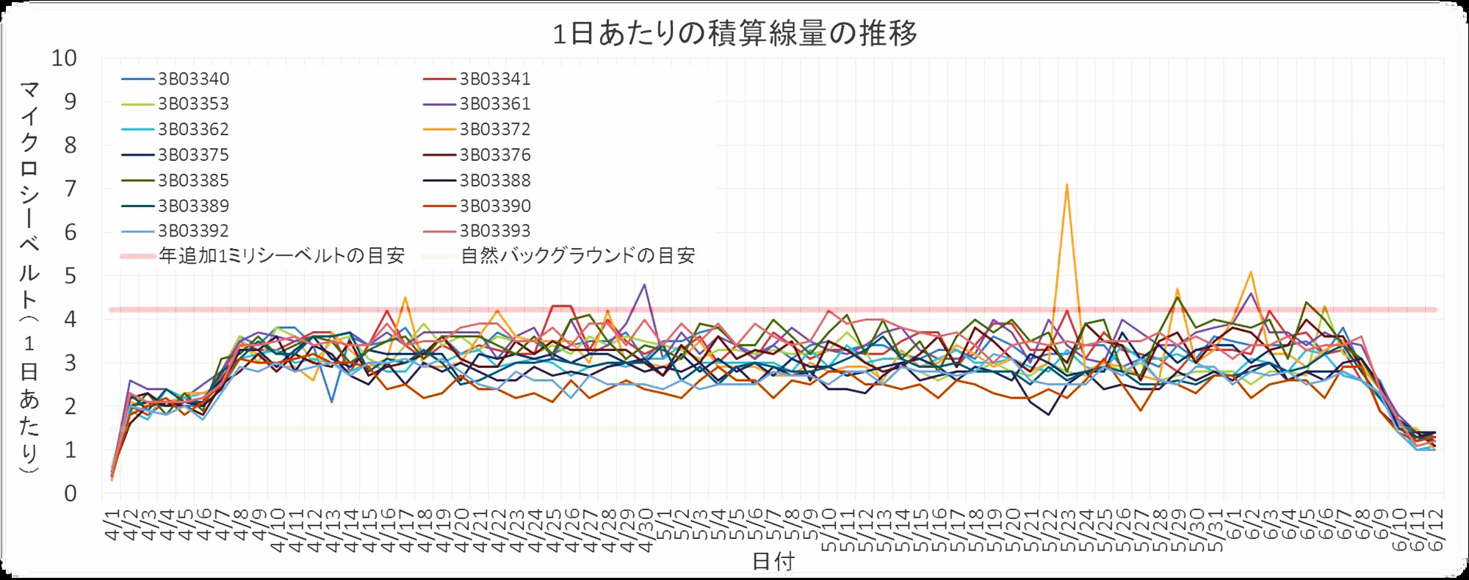
Radiation Level Remain Higher than
Before the Accident
Daily accumulated dose (μSv)
additional exposure dose 1mSv/y
natural background dose
Graph made by Dr Makoto Miyazaki, Fukushima Medical University
Compared to before the accident,
the actual daily life is affected, and inconveniences remain
Notes:
生活圏、測るという意志、暮らしへの意志

Slide 6
The Affected Area is Left in Unjust Situation after the Accident
We have to live in the unwanted situation in the additional radiation environment without any benefit.
We have to be careful to food.
Human relations and daily life are changed.
People don’t have to be careful in other places in Japan.
Only we suffer. Isn’t it unfair?
“No problem, just don’t mind.”
Do you mean that we should just accept this unjust situation?

Slide 7
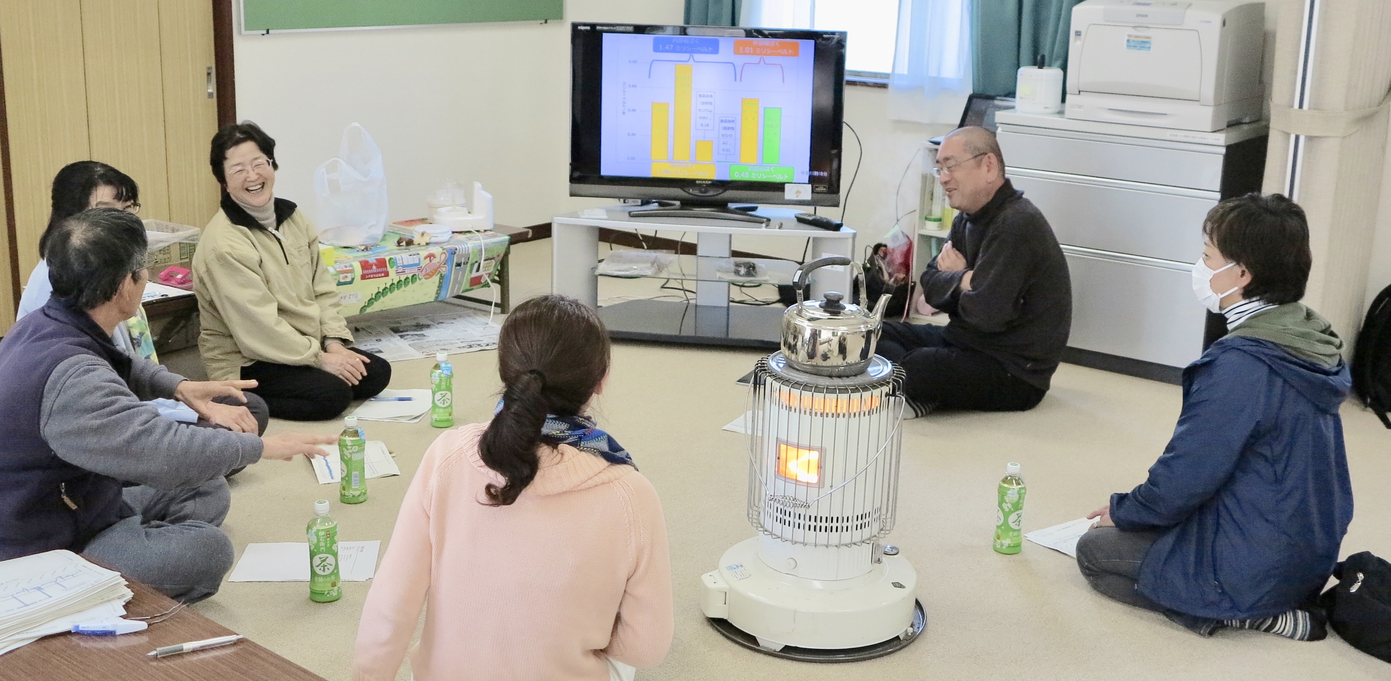
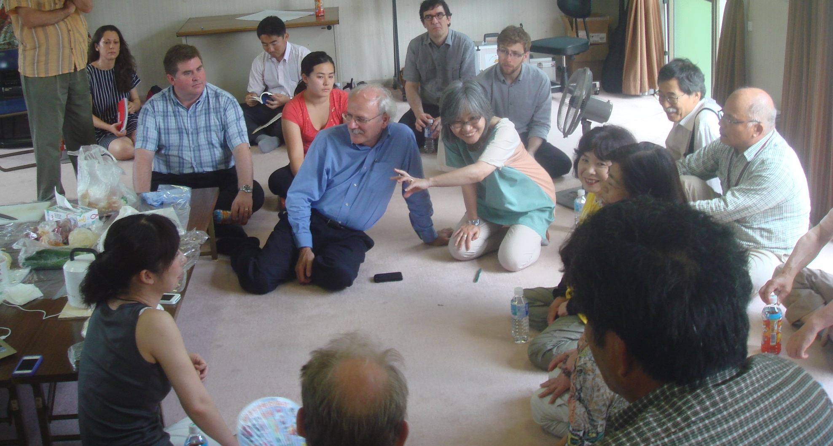
Bridge the Gap between Experts and Residents with Trust
Dr Makoto Miyazaki, Fukushima Medical University
Jacques Lochard
Kept coming back to Suetsugi
Spent time listening to residents
Giving professional advices understanding the unjust situation
-> Trust relationship with residents

Slide 8
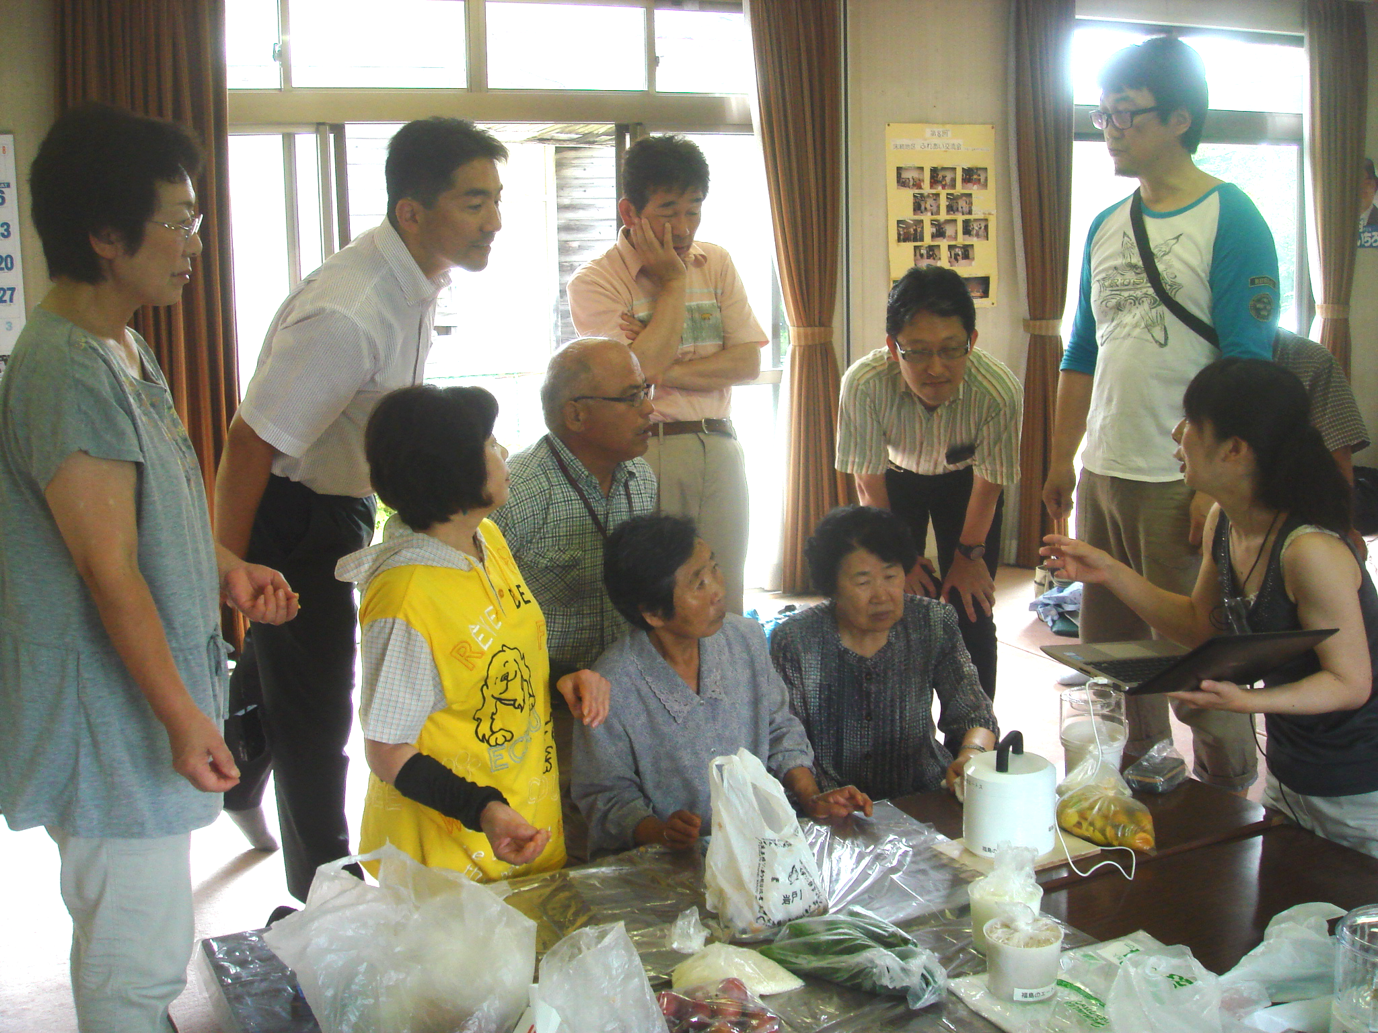

To Regain the Equity
How we can regain the equitable society?
Cf.
Monitoring system in the familiar environment
To tackle with the inconvenient daily life even after having recognized the unjust situation
A big step to be one who stands against the situation from a victim

Slide 9
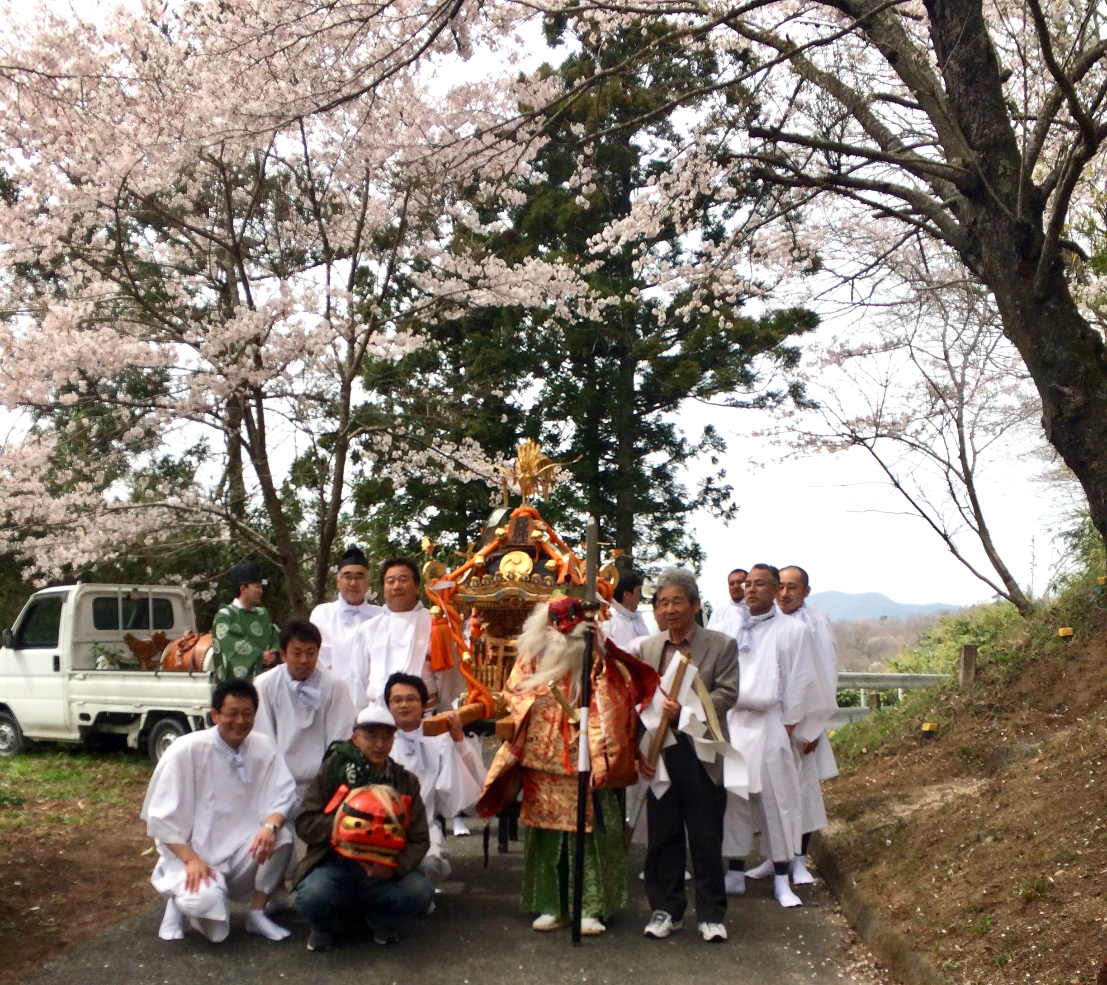
To Build Better Relationship between Science and Life
We look forward to your visit to Fukushima!

Slide 10
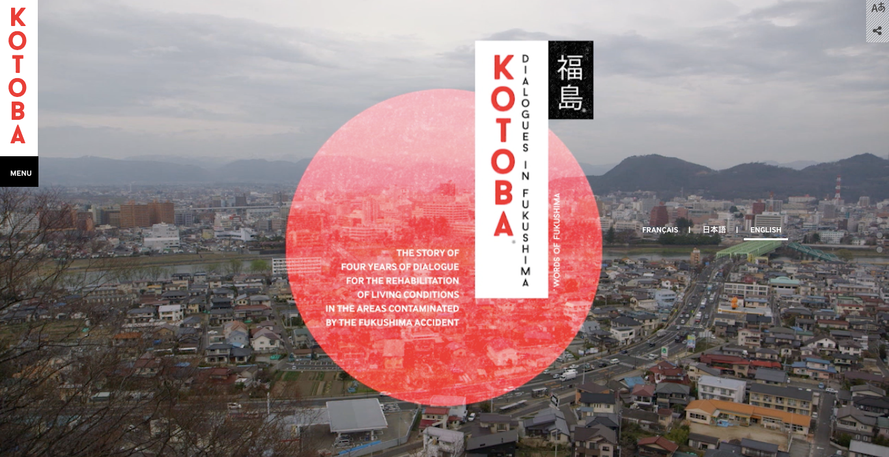
More Information
ETHOS IN FUKUSHIMA
http://ethos-fukushima.blogspot.jp
Kotoba Dialogue in FUKUSHIMA http://www.fukushima-dialogues.com

